Slide 1
Master Thesis: Defense Techniques
for Model Extraction Attacks on Deep
Learning Models
Fifth Round Discussion
Ridhima Garg (sa46jiza)
Supervisors
Prof. Dr. Christian Riess (FAU, Department of Computer Science)
Mr. Yannick Möll (ITK Engineering GmbH, Data-Driven Software and Sensors)

Slide 2
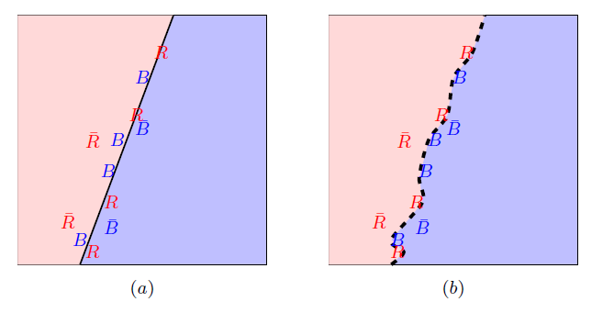
FRONTIER STICHING
Defense Technique for Model Extraction Attacks
Invasive: Changes to training process
GOAL: Use the adversarial samples to clamp original model in a unique and harmless way.
(a.) Calculate the true adversary (without bar) and false adversary (with bar). (b.) fine-tunes classifier to classify true ones.
06/02/2023
internal

Slide 3
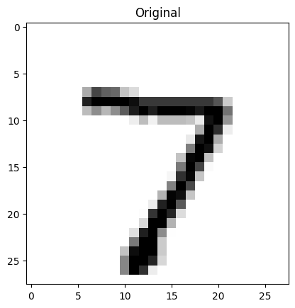
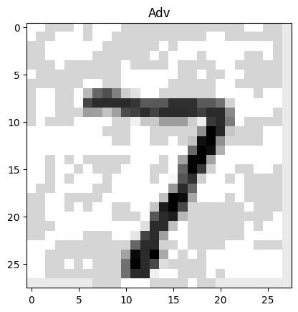
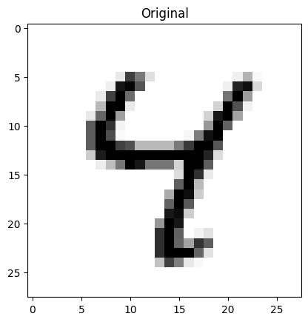
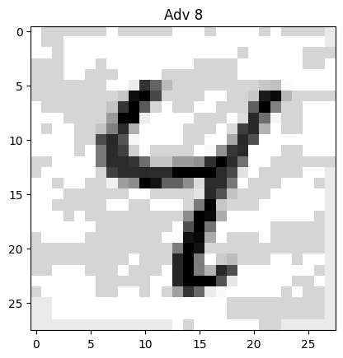
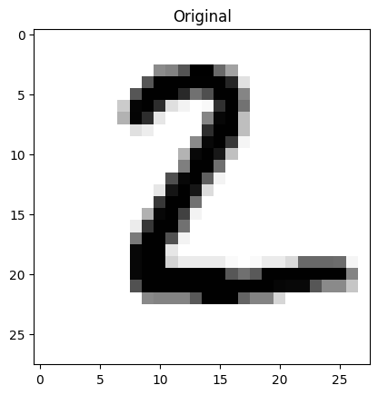
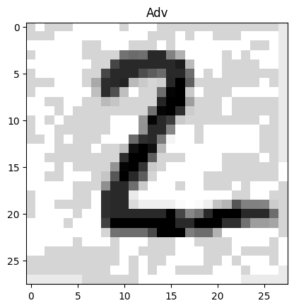
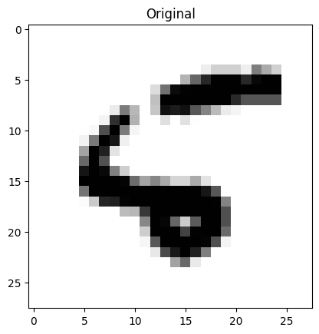
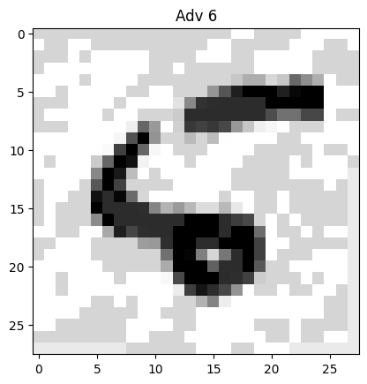
FRONTIER STICHING : Watermark samples
Prediction: 7
Prediction: 7 , Goal: 7
Prediction: 4
Prediction: 8 , Goal: 4
Prediction: 2
Prediction: 2 , Goal: 2
Prediction: 8
Prediction: 6 , Goal: 8
False Adversaries
True Adversaries
06/02/2023
internal

Slide 4
PHASE 1: Full adversaries with retraining

Slide 5
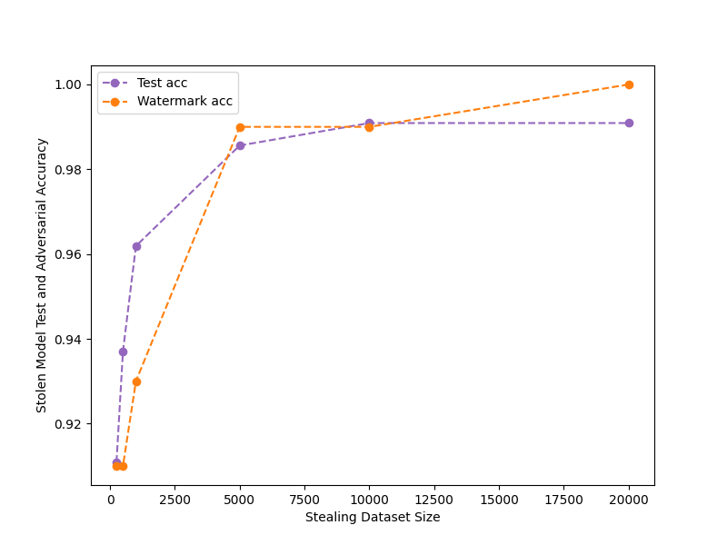
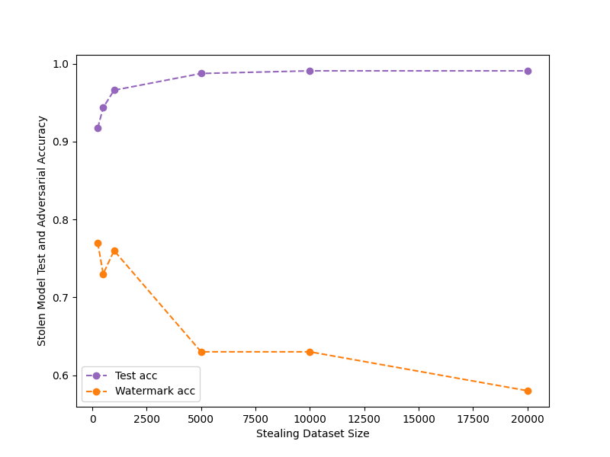
FALSE POSITIVES on MODEL Without FS ON MNIST
Attacking the model with epochs: 50, optimizer: adam, lr:0.001
eps=0.1, watermark_size =100
eps=0.25, watermark_size = 100

Slide 6
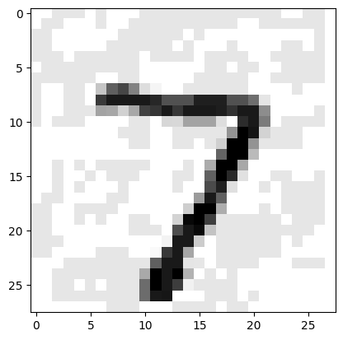
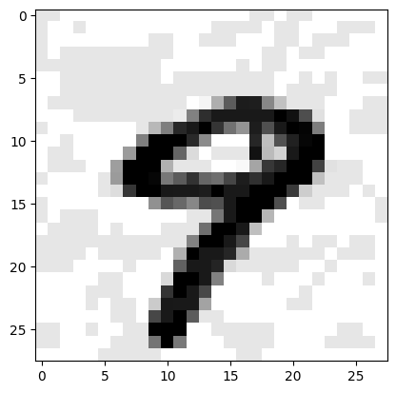
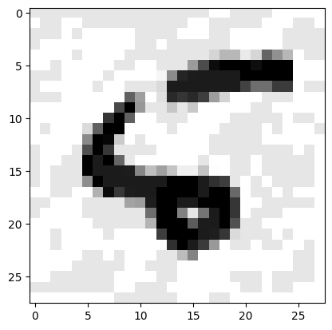
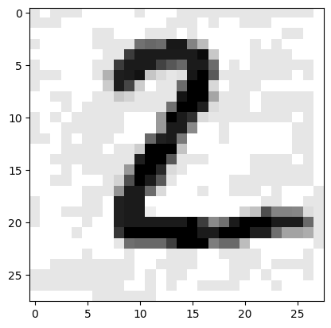
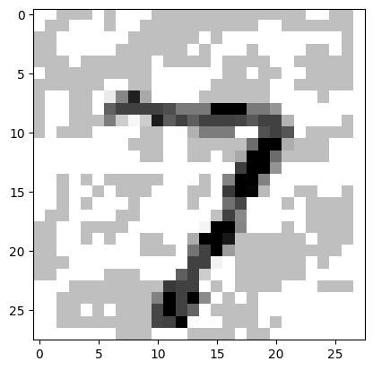

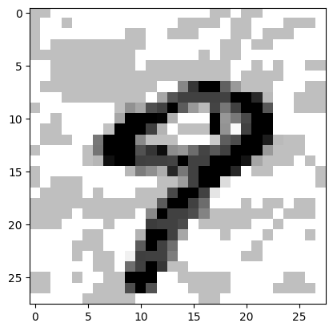
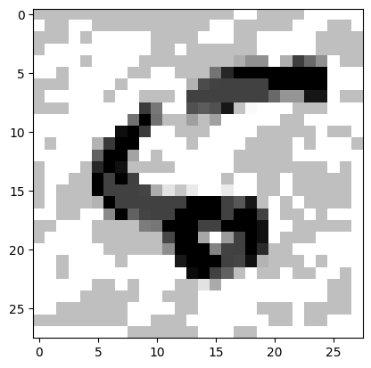
FALSE POSITIVES on MODEL Without FS ON MNIST
Attacking the model with epochs: 50, optimizer: adam, lr:0.001
eps=0.1
eps=0.25

Slide 7
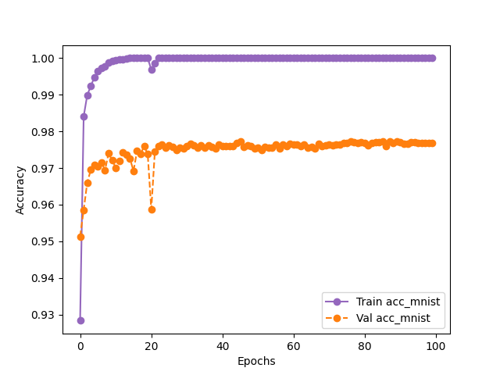
Retraining to watermark model FOR MNIST
Epochs - 100, eps - 0.25, watermark_size - 500
eps=0.25, watermark_size = 500
Dataset | Final Epoch Without Frontier (Victim - test) | Final Epoch After Frontier (using finetuning) (Victim - test) | Final Epoch After Frontier (Victim - watermark)
MNIST | 99.9 | 99.22 ( 0.5%) | 95.99

Slide 8
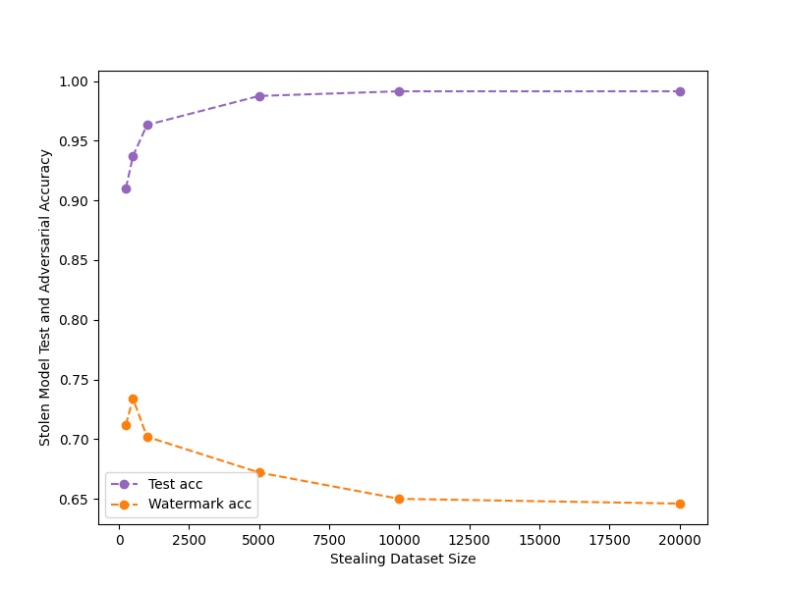
Attacking retrained (watermarked) model
Attack with architecture: MNIST – 2 conv layer, epochs: 50
eps=0.25, watermark_size = 500

Slide 9
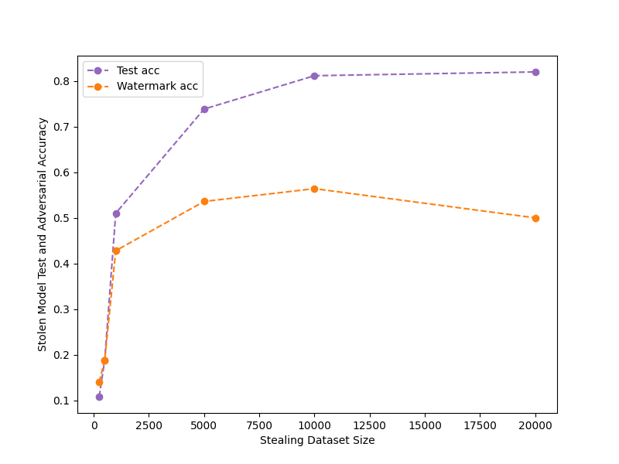
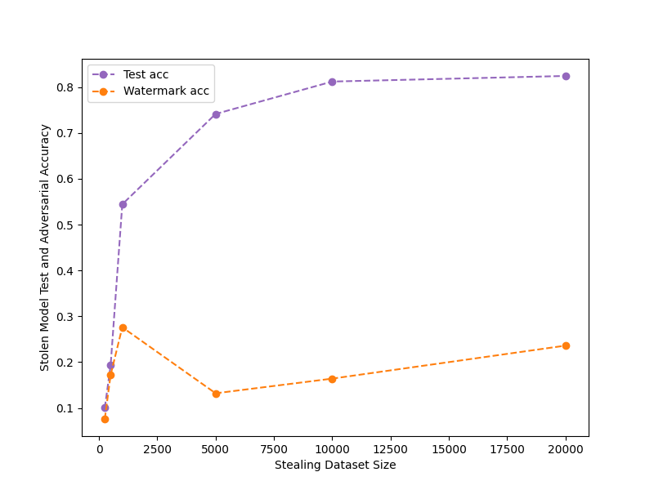
FALSE POSITIVES on MODEL Without FS ON CIFAR10
Attacking the model with epochs: 50, optimizer: adam, lr:0.001
eps=0.025, watermark_size = 250
eps=0.1, watermark_size = 250

Slide 10
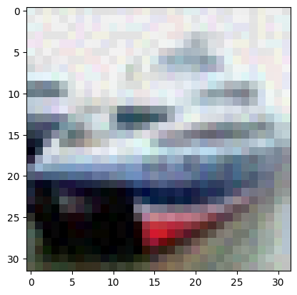
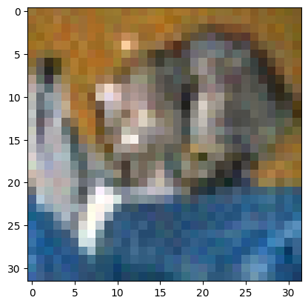
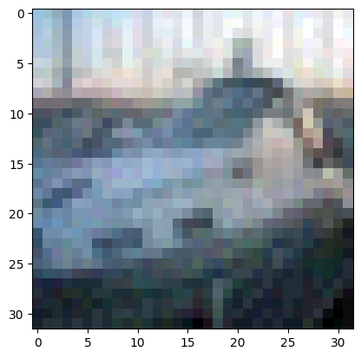
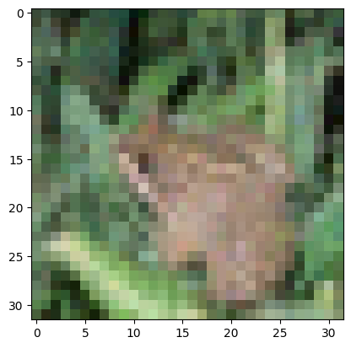
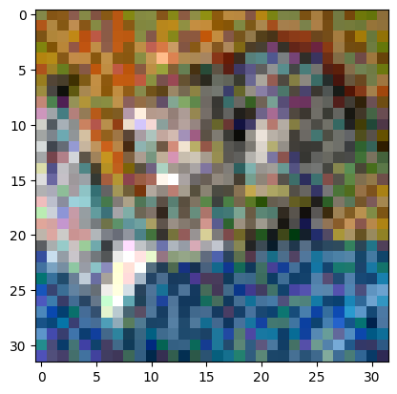
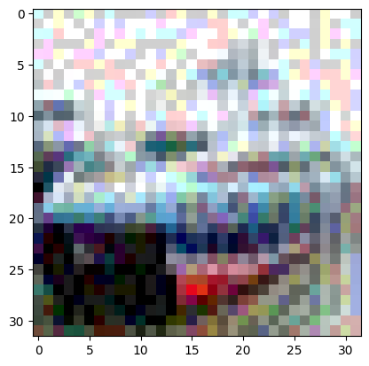
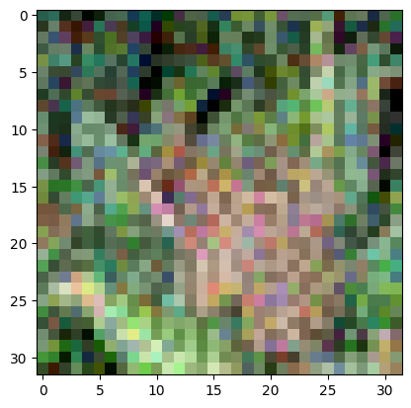
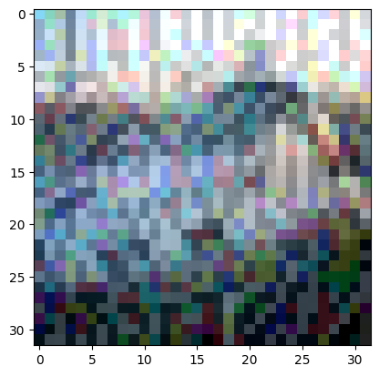
FALSE POSITIVES on MODEL Without FS on cifar10
eps=0.025
eps=0.1

Slide 11
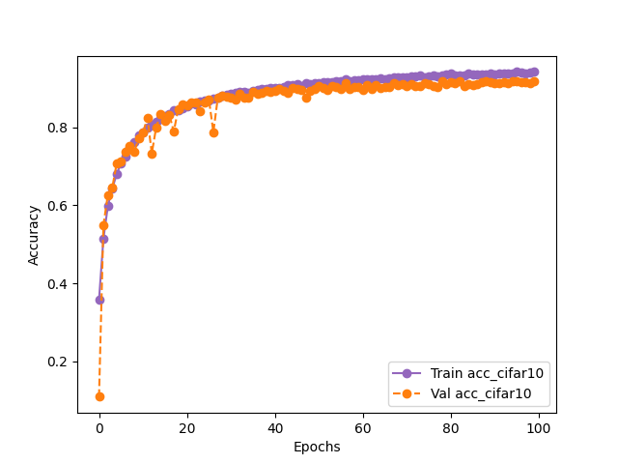
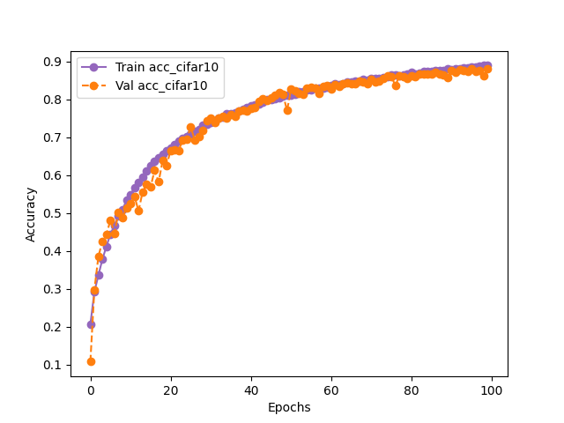
Retraining to watermark model for cifar10
eps=0.025, watermark_size =250
eps=0.1, watermark_size =250
Dataset (eps) | Final Epoch Without Frontier (Victim - test) | Final Epoch After Frontier (using finetuning) (Victim - test) | Final Epoch After Frontier (Victim - watermark)
CIFAR10 (0.025) | 85.4 | 84.86 ( 1%) | 43.99
CIFAR10 (0.1) | 85.4 | 82.02 ( 3%) | 11.99

Slide 12
PHASE 2: True adversaries with retraining

Slide 13
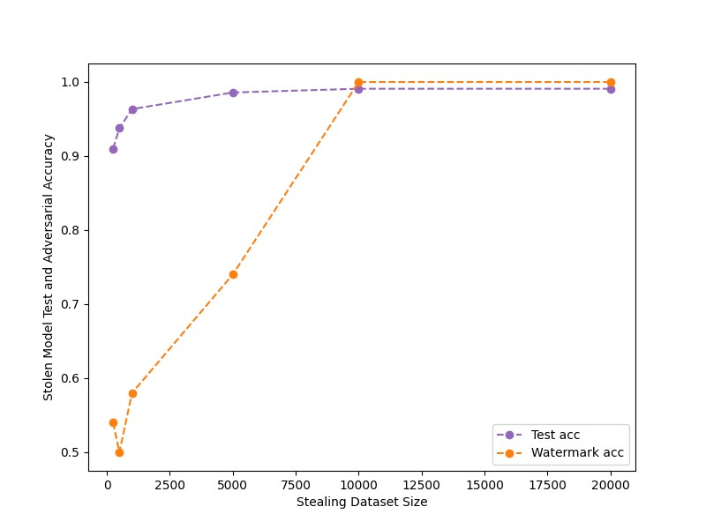
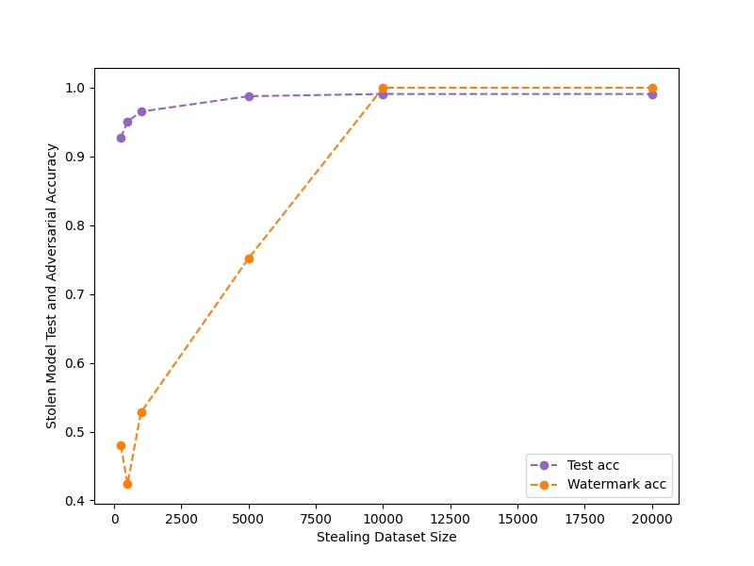
FALSE POSITIVES on MODEL Without FS ON MNIST
Only with true adversaries now.
eps=0.025, watermark_size =100
eps=0.025, watermark_size =250

Slide 14
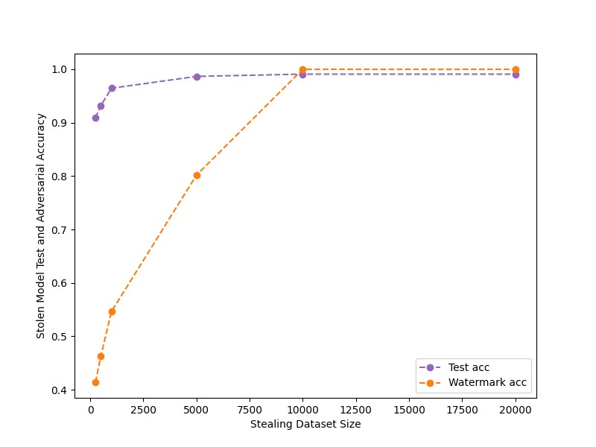
FALSE POSITIVES on MODEL Without FS ON MNIST
eps=0.025, watermark_size =10k

Slide 15
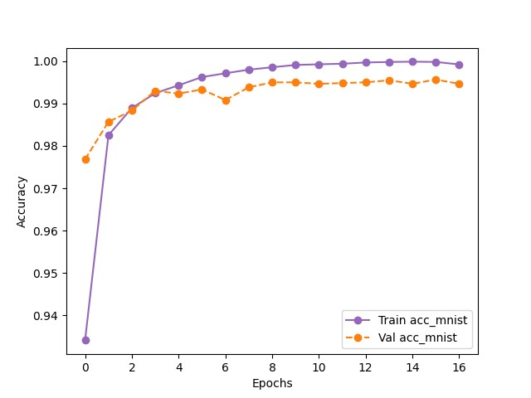
Retraining to watermark model
MNIST: 2-conv layer
Finetuning with noise level (eps = 0.025), lr : 0.001
eps=0.025, watermark_size =100
Dataset | Final Epoch Without Frontier (Victim - test) | Final Epoch After Frontier (using finetuning) (Victim - test) | Final Epoch After Frontier (Victim - watermark)
MNIST | 99.9 | 98.9 ( 1.1%) | 100

Slide 16
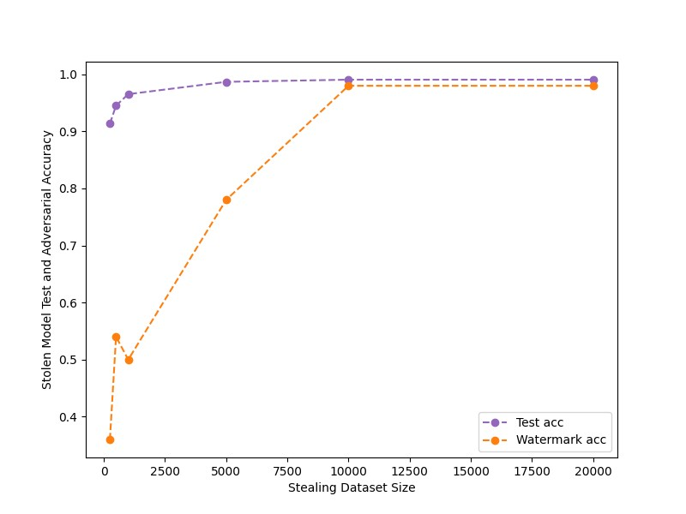
Attacking retrained (watermarked) model
Attack with architecture: MNIST – 2 conv layer, epochs: 50
eps=0.025, watermark_size =100

Slide 17
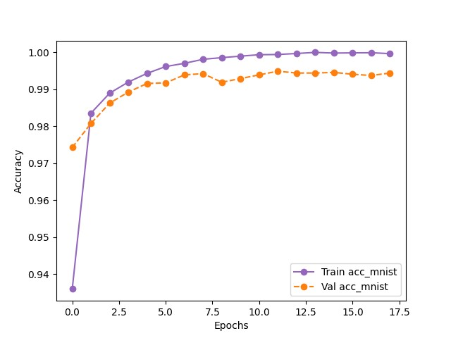
Retraining to watermark model
eps=0.025, watermark_size =10k
Dataset | Final Epoch Without Frontier (Victim - test) | Final Epoch After Frontier (using finetuning) (Victim - test) | Final Epoch After Frontier (Victim - watermark)
MNIST | 99.9 | 99.3 ( 0.5%) | 69.5

Slide 18
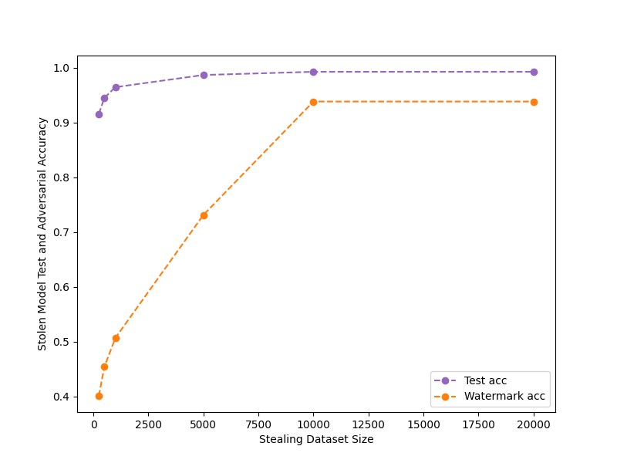
Attacking retrained (watermarked) model
eps=0.025, watermark_size =10k

Slide 19
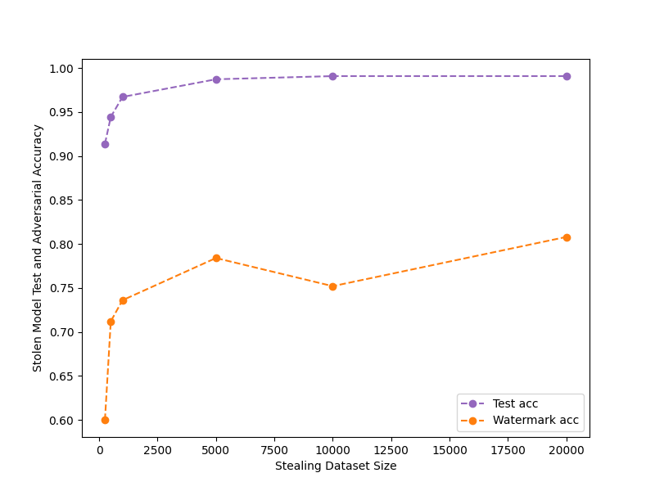
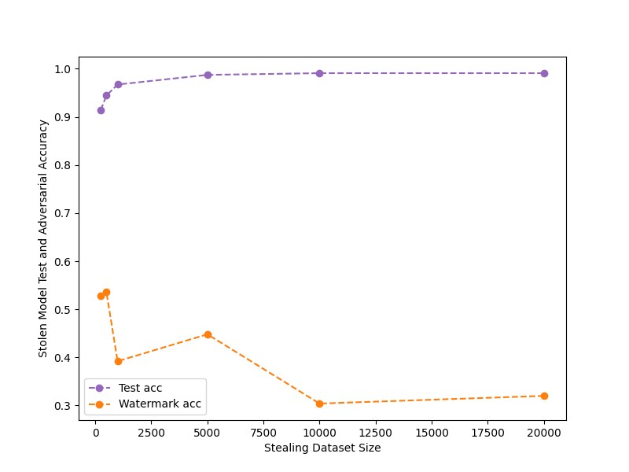
FALSE POSITIVES on MODEL Without FS ON MNIST
eps=0.1, watermark_size =250
eps=0.25, watermark_size =250

Slide 20
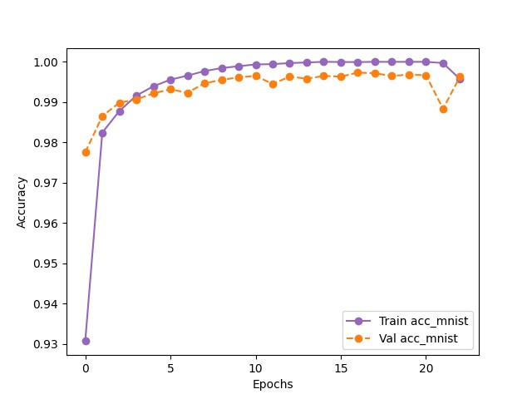
Retraining to watermark model
eps=0.25, watermark_size =250
Dataset | Final Epoch Without Frontier (Victim - test) | Final Epoch After Frontier (using finetuning) (Victim - test) | Final Epoch After Frontier (Victim - watermark)
MNIST | 99.9 | 98.6 ( 1.3%) | 84.6

Slide 21
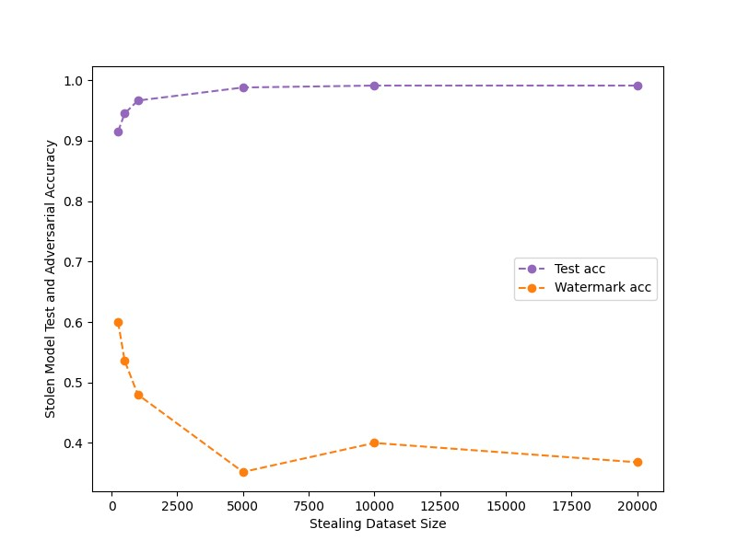
Attacking retrained (watermarked) model
eps=0.25, watermark_size =250

Slide 22
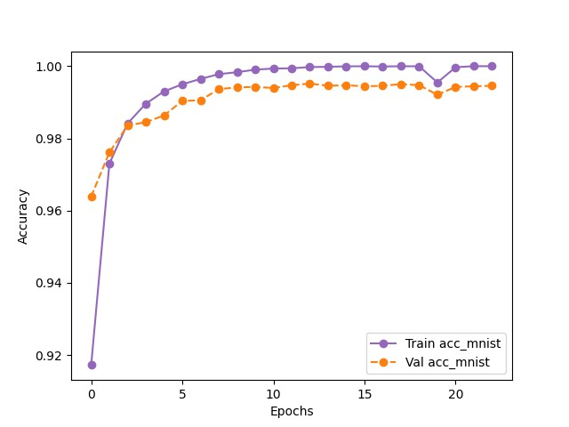
Retraining to watermark model
eps=0.25, watermark_size =10k
Dataset | Final Epoch Without Frontier (Victim - test) | Final Epoch After Frontier (using finetuning) (Victim - test) | Final Epoch After Frontier (Victim - watermark)
MNIST | 99.9 | 99.22 ( 0.7%) | 98.0

Slide 23
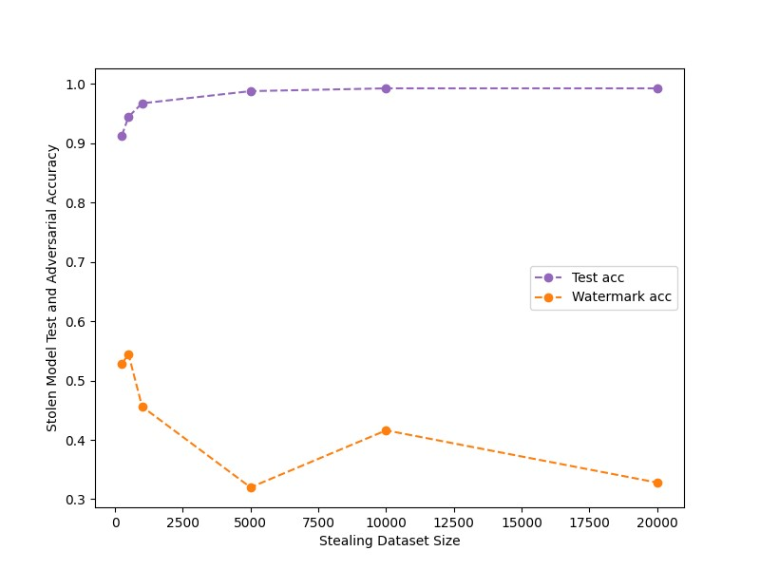
Attacking retrained (watermarked) model
eps=0.25, watermark_size =10k

Slide 24
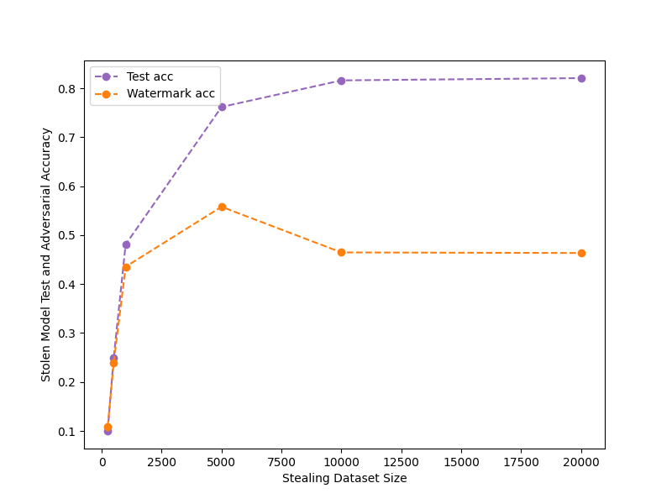
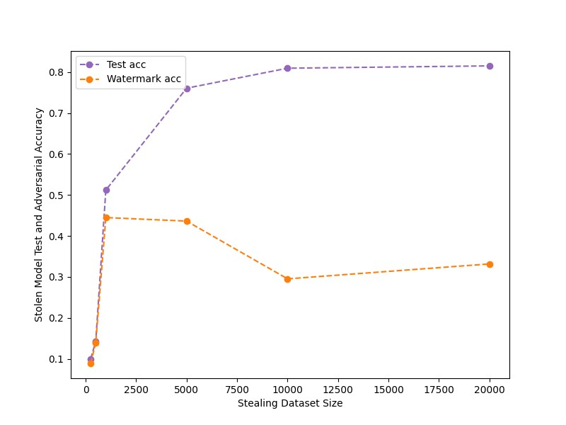
FALSE CLAIM AnALYSIS ON CIFAR10 Shallow NETWORK
Shallow Network : CIFAR10: 3-conv block with batchnorm and dropout
Using only true adversaries.
eps = 0.025
False claim with low confidence
eps = 0.035
False claim with low confidence
06/02/2023
internal

Slide 25
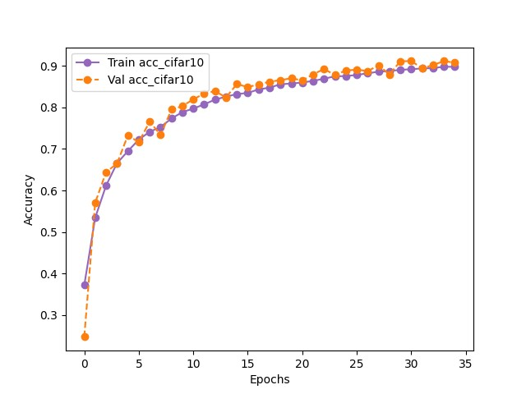
Retraining to watermark model
eps=0.035, watermark_size =100
Dataset | Final Epoch Without Frontier (Victim - test) | Final Epoch After Frontier (using finetuning) (Victim - test) | Final Epoch After Frontier (Victim - watermark)
MNIST | 82.5 | 82.24 ( 0.3%) | 62.0

Slide 26
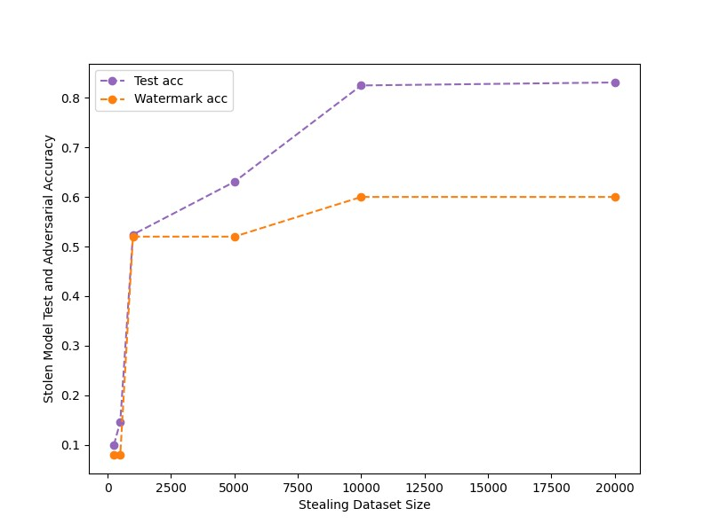
Attacking retrained (watermarked) model
eps=0.035, watermark_size =100

Slide 27

Retraining to watermark model
eps=0.035, watermark_size =10k
Dataset | Final Epoch Without Frontier (Victim - test) | Final Epoch After Frontier (using finetuning) (Victim - test) | Final Epoch After Frontier (Victim - watermark)
MNIST | 82.5 | 82.3 ( 0.2%) | 81.67

Slide 28
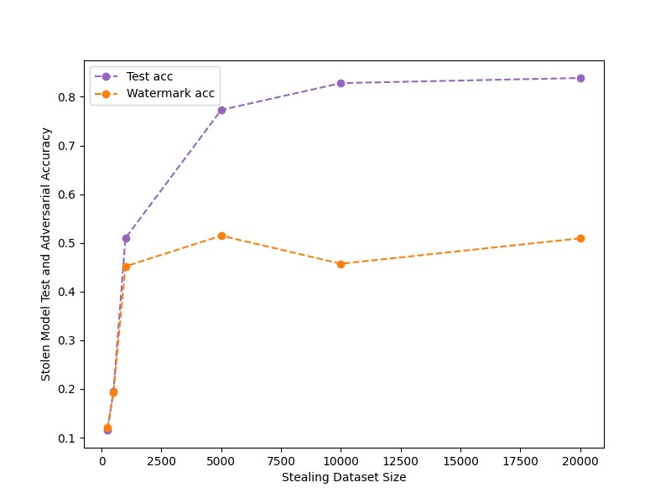
Attacking retrained (watermarked) model
eps=0.035, watermark_size =10k

Slide 29


Retraining to watermark model for cifar10
eps=0.025, watermark_size =10k
Dataset (eps) | Final Epoch Without Frontier (Victim - test) | Final Epoch After Frontier (using finetuning) (Victim - test) | Final Epoch After Frontier (Victim - watermark)
CIFAR10 (0.025) | 85.4 | 84.86 ( 1%) | 43.99

Slide 30
PRoBABLISTIC APPROACH FOR CLAIMING OWNERSHIP
Theta: max no. of errors tolerated for the watermark set from adversary model.
If no. of errors < theta : model is watermarked.
Triggers are generated with noise = 0.1 and 100 watermark size
Dataset | No. Of queries | Frontier Stitching Watermarking Claim | False predictions | False Prediction Tolerance
MNISTL2 (drop=0) | 250 | True | 23 | 42
MNISTL2 (drop=0) | 500 | True | 23 | 42
MNISTL2 (drop=0) | 1000 | True | 20 | 42
MNISTL2 (drop=0) | 10000 | True | 20 | 42
MNISTL2 (drop=0) | 20000 | True | 16 | 42

Slide 31
FROntier STICHING
P-value approach to decision criteria
Z: mismatching labels for the watermark set from adversary and non-watermarked model
Probability that there will be z errors P(Z < theta | f_{a}(w) = f_{v}(w)) < p-value, model is attacked.
For watermark size =100 and p-value = 0.05 : theta: 42
For watermark size =20 and p-value = 0.05 : theta: 6
06/02/2023
internal

Slide 32
PHASE 3: True adversaries with Finetuning

Slide 33
FALSE CLAIM AnALYSIS ON CIFAR10 Shallow NETWORK
Shallow Network : CIFAR10: 3-conv block with batchnorm and dropout
Using only true adversaries.
eps = 0.025
False claim with low confidence
eps = 0.035
False claim with low confidence
06/02/2023
internal

Slide 34




FALSE CLAIM AnALYSIS ON CIFAR10 Shallow NETWORK
eps = 0.035

Slide 35

Learning rate for finetuning
Finetuning the pretrained network only on watermark samples.
The network will forget the old weights.
To overcome this: the starting learning rate is chosen small, and then smoothly increased (new distribution is learnt at a faster pace, without forgetting the distribution of original samples), and then the learning rate is reduced fast, without too much time to overfit.
Slow start, Fast decay
Learning Rate Schedule

Slide 36


Finetuning to embed watermark
CIFAR10: 3-conv block with batchnorm and dropout
Finetuning with noise level (eps = 0.035),
Learning rate - epoch <= 20 : (0.0001 * epoch) and epoch > 20 : power(2, (epoch -5))
Finetuning with 25 epochs
With learning rate pattern (to increase and decrease)

Slide 37
FIDELITY (DECREASE IN ACCURACY of original model)
Dataset | Final Epoch Without Frontier (Victim - test) | Final Epoch After Frontier (using finetuning) (Victim - test) | Final Epoch After Frontier (Victim – watermark)
CIFAR10 | 82.5 | 74.9 ( 8 %) | 82.9

Slide 38

Attacking Finetuned (watermarked) model
Original Model - CIFAR10 3-conv block with batch norm and dropout
Attack with architecture: CIFAR10 3-conv block, epochs: 50, averaged: 5 runs
Representing the 5 runs by taking the 20th quartile and 90th quartile.
Conclusion
Acc_{wm} (watermark acc) is preserved with more than 90% confidence for every run from a lower to a higher number of queries.

Slide 39

Attacking Finetuned (watermarked) model
Original Model - CIFAR10 3-conv block with batch norm and dropout
Attack with architecture: ResNet , epochs: 50, averaged: 5 runs
Representing the 5 runs by taking the 20th quartile and 90th quartile.
Conclusion
Acc_{wm} (watermark acc) is preserved with good confidence but the variations throughout runs are little high.

Slide 40


FALSE CLAIM AnALYSIS ON CIFAR10 DEEP Network
Deep Network : CIFAR10: ResNet
Using only true adversaries.
eps = 0.015
False Claim
eps = 0.025
False claim with very low confidence

Slide 41




FALSE CLAIM AnALYSIS ON CIFAR10 DEEP Network
eps = 0.025

Slide 42


Finetuning to embed watermark
CIFAR10: ResNet
Finetuning with noise level (eps = 0.025)
Finetuning with 10 epochs
Observation
With a higher number of epochs (e.g. 25) then the model was overfitting only the watermark set and forgetting the previous weights.

Slide 43
FIDELITY (DECREASE IN ACCURACY of original model)
Dataset | Final Epoch Without Frontier (Victim - test) | Final Epoch After Frontier (using finetuning) (Victim - test) | Final Epoch After Frontier (Victim - watermark)
CIFAR10 | 96.05 | 88.91(~89) ( 7%) | 83.2

Slide 44

Attacking Finetuned model
Original Model - CIFAR10 ResNet
Attack with architecture: CIFAR10 3-conv block, epochs: 50, averaged: 5 runs
Conclusion
Acc_{wm} (watermark acc) is preserved between 79% to 85% confidence for every run from lower to higher number of queries.

Slide 45

PRUNING
Without pruning Test acc: 72.06 Watermark acc: 66.68
- Performing pruning on the attacker model.
Pruning level | Watermark Acc | Clean Test Acc
0.025 | 57.34 | 72.0
0.3 | 57.44 | 72.0
0.5 | 52.88 | 72.66
0.75 | 13.39 | 18.06
0.9 | 10.38 | 10.11

Slide 46

FALSE CLAIM AnALYSIS ON MNIST
eps=0.025, watermark_size =10k
eps: 0.25, watermark_size = 10k

Slide 47


Finetuning to embed watermark on MNIST
MNIST: 2-Conv layer
Finetuning with noise level (eps = 0.025 and 0.25)
Finetuning with 20 epochs,
eps = 0.025
Finetuning with 25 epochs,
eps = 0.25

Slide 48
FIDELITY (DECREASE IN ACCURACY of original model)
Dataset | Final Epoch Without Frontier (Victim - test) | Final Epoch After Frontier (using finetuning) (Victim - test) | Final Epoch After Frontier (Victim - watermark)
MNIST (0.025)
MNIST (0.25) | 99.08 | 96.49 ( 3%) | 93.8

Slide 49


Attacking Finetuned model
eps = 0.025
eps = 0.25

Slide 50
Conclusion
Frontier Stitching
Focus of the work is more on Fidelity metrics instead of watermark preserving.
We fixed the issue by introducing finetuning and using only true adversaries.
Robust towards watermark removal attacks – pruning.
Attack is successful in black box setting (architecture of victim is unknown to adversary).
Not using a probabilistic approach as we are knocking off false positives by using only true adversaries.
General Watermarking
All works have focused on when attacker is attacking with large no. of queries.

Slide 51
RECAP: Defense on Trained model APPROACHES
Model (trained on task, without watermark)
Model (trained on task, without watermark)
Model (trained on task, without watermark)
Same model architecture
Different model architecture (take input from above model)
Different model architecture (take input from above model)
Model finetuning with watermark set
Model training with watermarking on new model only.
Model training with watermarking keeping some layers unfreezed of base model.
Transfering weights
Finetuning with all layers freezed
Finetuning with some layers freezed
07/28/2023
internal

Slide 52
RECAP: FINAL EXPERIMENT RESULTS OVERVIEW
Datasets – MNIST, CIFAR10
Models – 2/3 layer ConvNet (with and without dropout), ResNet
Dataset (Model architecture) | Defense Method | Model without defense |  | Model with defense (scratch or retraining) |  |  |  | Model with defense (finetuning)
 |  | Acc_{test} | Acc_{w} | Victim Model |  | Adversary Model |  | Victim Model |  | Adversary Model
 |  |  |  | Acc_{test} | Acc_{w} | Acc_{test} | Acc_{w} | Acc_{test} | Acc_{w} | Acc_{test} | Acc_{w}
MNIST (2-Conv) | DAWN / EWE / FS
CIFAR10 (ResNet) | DAWN / EWE / FS
CIFAR10 (3-conv block) | DAWN/ EWE / FS

Slide 53
NEXT Steps AND Discussion
Experiments
Finalizing DAWN
Revisiting Entangled Watermarking – quite a few work is remaining there.
Writing
Outline of the thesis
Template
06/02/2023
internal

Slide 54
06/02/2023
internal

Slide 55
FIDELITY (DECREASE IN ACCURACY of original model)
Dataset | Final Epoch Without frontier (Victim - test) | Final Epoch After frontier (using finetuning) (Victim - test) | Final Epoch After frontier (Victim - watermark)
CIFAR10 | 96.05 | 68.1 ( ~20%) | 75.9
Finetuning with 25 epochs
With learning rate pattern (to increase and decrease)

